Slide 1
Nagle's algorithm
husseinnasser
Delay in the client side

Slide 2
Nigel Algorithm
husseinnasser
In the telnet days sending a single byte in a segment is a waste
Combine small segments and send them in a single one
The client can wait for a full MSS before sending the segment
No wasted 40 bytes header (IP + TCP) for few bytes of data

Slide 3

Nagle's algorithm
Delay
husseinnasser
Assume MSS = 1460, A sends 500 bytes
500 < 1460 client waits to fill the segment
A sends 960 bytes, segment fills and send
If there isn’t anything to ACK data will be immediately sent
A
B
2
500
2
1460
1460

Slide 4
Problem with Nagle's algorithm
Delay
husseinnasser
Sending large data causes delay
A want to send 5000 bytes on 1460 MSS
3 full segments of 1460 with 620 bytes
4th segment is not sent!
4th not full segment are only sent when an ACK is received
A
1460
1460
1460
B
2
620
ACK
2
620

Slide 5
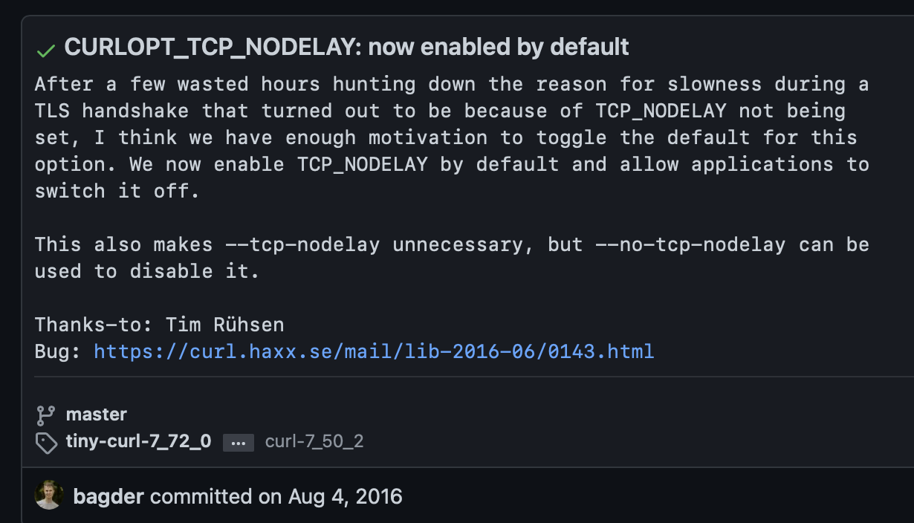
Disabling Nagle's algorithm
husseinnasser
Most clients today disable Nagle's algorithm
I rather get performance than small bandwidth
TCP_NODELAY
Curl disabled this back in 2016 by default because TLS handshake was slowed down
https://github.com/curl/curl/commit/4732ca5724072f132876f520c8f02c7c5b654d9

Slide 6
Delayed Acknowledgement
husseinnasser
Less packets are good but performance is better

Slide 7
Delayed Acknowledgment algorithm
Delay
ACK all at once
husseinnasser
Waste to acknowledge segments right away
We can wait little more to receive more segment and ack once
2
1
B
A
4
3
5
ACK 5

Slide 8
Problem with delayed ACK
Delay
Delay
400 ms in some cases
husseinnasser
Causes delays in some clients that may lead to timeout and retransmission
Noticeable performance degradation
Combined with Nagle's algorithm can lead to 400ms delays!
Each party is waiting on each other
A
1460
1460
1460
B
2
620
ACK
2
620

Slide 9
Disabling Delayed acknowledgement algorithm
husseinnasser
Disable delayed ack algorithm can be done with TCP_QUICKACK option
Segments will be acknowledged “quicker”

Slide 10
The Cost of Connections
husseinnasser
Understanding the cost of connections

Slide 11
Connection establishment is costly
husseinnasser
TCP three way handshake
The further apart the peers, the slower it is to send segments
Slow start keeps the connection from reaching its potential right away
Congestion control and flow control limit that further
Delayed and Nigel algorithm can further slow down
Destroying the connection is also expensive

Slide 12
Connection Pooling
husseinnasser
Most implementation database backends and reverse proxies use pooling
Establish a bunch of TCP connection to the backend and keep them running!
Any request that comes to the backend use an already opened connection
This way your connections will be “warm” and slow start would have already kicked in
Don’t close the connection unless you absolutely don’t need it

Slide 13
Eager vs Lazy Loading
husseinnasser
Depending on what paradigm you take you can save on resources
Eager loading -> Load everything and keep it ready
Start up is slow but requests will be served immediately
Some apps send warm up data to kick in the slow start but be careful of bandwidth and scalability
Lazy Loading -> only load things on demand
Start up is fast but requests will suffer initially

